Slide 1
Practical cases
Digital Signage

Slide 2
10 reasons to use digital signage
Data | Ground on
Using a variety of channels to promote your brand is a priority for more than 25% of organizations | DS systems is a crucial part of multichannel marketing strategy. Digital displays is a kind of canvas for an endless number of promotions, advertising and other content. DS allow building a network between online and offline promotion tools, leaving the target audience with a vivid impressions.
Digital signage attracts attention – confirmed by 63% of people | The DS efficiency index is far ahead of the performance indicators of TV, the Internet and even advertising stands. By introducing the technology the company makes the right choice based on decreasing the cost, providing flexibility, opportunities and high influence on buying activity.
Digital advertising significantly increase brand awareness (BA) Based on 84% of companies from the UK | DS introduces target audience with the store and a brand, increasing the company's recognition. Compared to static messages, dynamic images are more visible and more effective in improving communication between the company and its customers
Digital video attracts attention of 70% of the audience. | DS content provides interesting information and allows spending time in the queue more interesting. But what really makes DS a serious competitor to other channels of communication is the reach of the audience: SMM or sites with online video do not reach 45% of the contact audience. Digital signage allows you to convey information to 70% of the audience
42% of buyers prefer to shop in stores equipped with video displays. | The newest 4K Ultra HD video format significantly improves the image on video walls, allowing stores to switch to affordable and effective ways to inform their customers. Video walls leave an unforgettable impression for clients, allowing creating a unique atmosphere for them. Throughout the world, there are more and more amazing projects demonstrating how to use digital technologies correctly.

Slide 3
Data | Ground on
Decreases time on waiting in queues by 35%. | Entertaining DS content solves the problem of customers' waiting by their turn. Modern professional DS-media players allows managing content remotely, update it in seconds. Such opportunities turn the DS into an effective professional marketing tool that brighten up the waiting time for the customer.
Digital menus and menu boards affect the purchasing decisions – confirmed by 30% of visitors | Restaurants, mainly from the fast food industry, have switched on using of digital menus, automatically and unmistakably displaying the necessary menus and promotions in the right place and at the right time.
TOP 50/100 retail companies in the USA test beacons. | Beacons devices send messages to the client's smartphone via Bluetooth Low Energy technology when the user reaches a certain radius. Beacons expand DS capabilities by opportunity to send personalized message to the customer's smartphone: information about discounts, promotions, etc. All the messages you wanted to convey to customers will be visible on personal gadgets.
> 60% of purchasing decisions Are taken at the point of sale. | Shops should not be afraid of such a modern trend as the examination of goods without purchase: the customer's decision will be formed under the impression of a pleasant atmosphere and emotions created by digital technologies.
Increase sales on 31,8% | Using DS, stores can make the shopping process more comfortable and efficient. DS creates a pleasant atmosphere, with the help of the right content, increasing sales and the speed of acceptance by the buyer of the solution.

Slide 4
The correct information on Prestigio IDS and Prestigio IDS SW at the right time can push the customer to the choice
Increases the number of checks by more than 15%
The number of POS visits grows by 20-40%
The number of contacts with the potential buyer increases in 5-7 times
Online video update for 10-25 seconds
ROI in less than 12 months

Slide 5
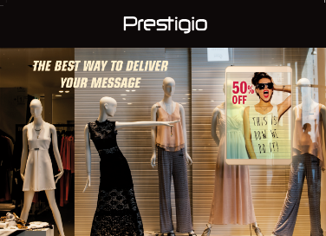
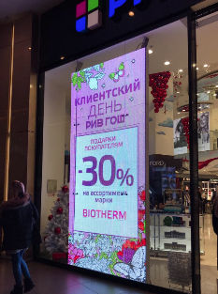
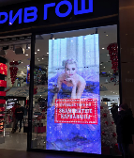
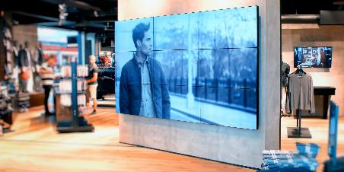
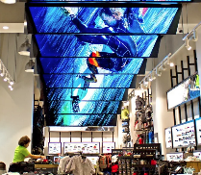
IDS (Non)- transparent video walls and poster displays Fashion retail
A new generation of Prestigio devices is a bright juicy and a live content aimed at attracting new visitors.
USE BENEFITS
Bright juicy dynamic images in fast-moving environment
Personalized content advertising depending on the user (gender, age)
Interactive shopping navigation
Automated remote update of content, promotions
Displaying content on a schedule
Impression Analytics
Transparency of the device up to 87%
CUTTING COSTS/ INCREASING PROFIT
Digital advertising is more effective than printed materials on 28%
Digital advertising increases sales of advertised products and apparently raise the average bill
Digital ads deliver more accurate information than shop assistants and eliminate human errors
Significantly saves the budget in long-term period
Provides high ROI via vendor & third parties advertising
Project Cost of the ready solution:
Prcies:
Poster device
SW Prestigio Addreality (subscription) -
* With each purchase of Full Solution (IDS+SW) the buyer receives free 30 days-trial software use.

Slide 6
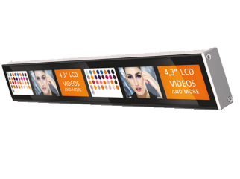
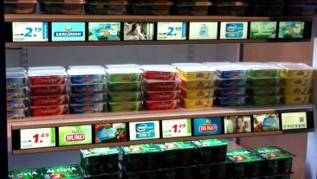
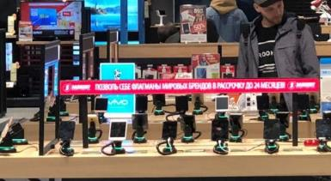
IDS Shelf signage LED displays, Retail/DIY/Electronic shops
USE BENEFITS
Displaying dynamic price promos, checking and update;
Expanding advertising campaigns;
Demonstrating product images, reviews;
Suggesting cross promo recommendations;
Remote and centralized control;
Highlighting Brand among competitors;
Targeting and delivering highly personalized, valuable experiences to demanding shoppers
CUTTING COSTS/ INCREASING PROFIT
Digital advertising is more effective than printed materials on 28%
Digital advertising increases sales of advertised products and apparently raise the average bill
Digital ads deliver more accurate information than shop assistants and eliminate human errors
Significantly saves the budget in long-term period
Provides high ROI due to vendor & third parties advertising promo and participation
Project cost
Display | Cost, 1pcs. | Final cost, if the store has 2 shelves with 1m length
Shelf Signage | $ (L-600 mm), $ (L-300 mm) | Shelf Signage 600 mm 1 pcs + Shelf Signage 300 mm 1 pcs
charger | $ (150 W) | 1 pcs (Depends on number of devices) = $
Intel NUC (Mini PC) | $ | 1 pcs. = $
SWPrestigio Addreality | $/month * With each purchase of Full IDS Solution (IDS+SW) the buyer receives free 30 days-trial software use.
Total project cost |  | $

Slide 7
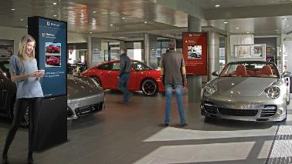
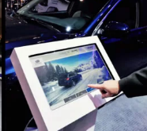

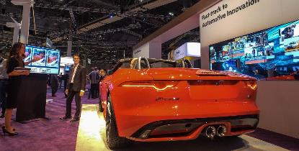
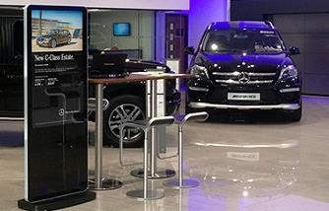
IDS Digital Displays IN/Outdoor Displays Auto Dealers
A new generation of Prestigio devices is a bright juicy and a live content aimed at attracting new visitors.
USE BENEFITS
Interactive car configurators with touch
Showing the characteristics of cars depending on the audience
Distributing content depending on the car placed for sale
An interactive function that allows users to change the characteristics of a car, such as color and discs,etc
On-line service
Automatic remote content update with software
Project Cost of the ready solution:
Prcies:
IDS device
SW Prestigio Addreality (subscription) -
* With each purchase of Full Solution (IDS+SW) the buyer receives free 30 days-trial software use.
CUTTING COSTS/ INCREASING PROFIT
Digital is more effective than Print due to dynamic and personalized content via Prestigio Addreality SW
Cost-Savings solution to free assistant enviroment
Time-Saving customer solution to find the right cars in stock
Consistent content that engage customer both outdoor and via indoor IDS (as a video wall, poster) in showroom

Slide 8
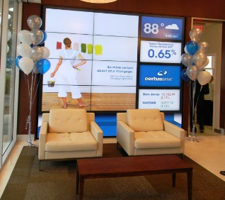
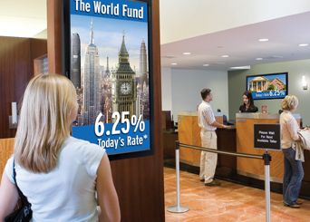
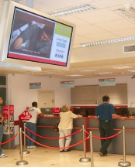
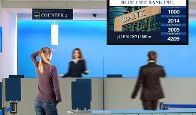
IDS Digital Signage Banks and Financial Institutions
USE BENEFITS
Navigation of the bank branch
Individual communication with the client and display of shares and specials. proposals with the introduction of beacon technologies
On-line service
Remote content update with software
Project Cost of the ready solution:
Prcies:
Poster device
SW Prestigio Addreality (subscription) -
* With each purchase of Full Solution (IDS+SW) the buyer receives free 30 days-trial software use.
CUTTING COSTS/ INCREASING PROFIT
Sale of third parties promotion and advertising space for goods which can be acquired via credit
Cross sale external services.
Electronic advertising is more effective than printed materials on 28%

Slide 9
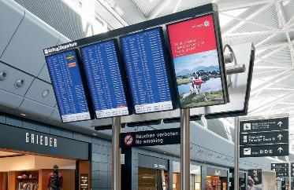
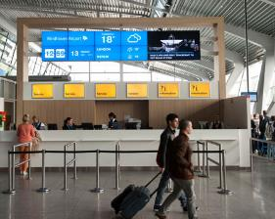

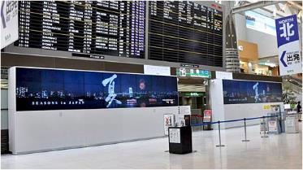
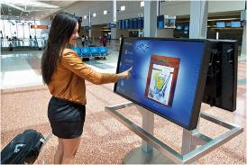
Interactive Digital signage Transport terminals
A new generation of Prestigio devices is a bright juicy and a live content aimed at attracting new visitors.
Project Cost of the ready solution:
Prcies:
Device costs
SW Prestigio Addreality (subscription) -
* With each purchase of Full Solution (IDS+SW) the buyer receives free 30 days-trial software use.
USE BENEFITS
Interactive navigation for providing information about restaurants, cafes and entertainment in the territory of the transport terminal
Use of a kiosk for lost&found services
IDS for promoting the country of arrival including local hotels and attractions
Security is the main priority of the transport terminal. Kiosk - a tool for posting information about the necessary measures of caution and social advertising
CUTTING COSTS/ INCREASING PROFIT
Digital advertising is more effective than printed materials on 28%
Provides high ROI due to vendor & third parties advertising promo and participation
Provides of passengers for the consistent subsequent online advertising
Cost-saving due remote management and centralized content updates

Slide 10
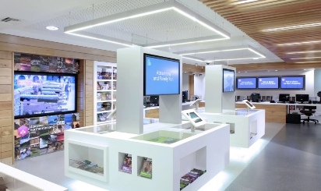
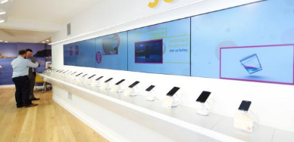
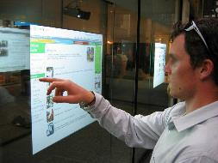

IDS Demo brand module - IT retail
CUTTING COSTS/ INCREASING PROFIT
Increase sales through valuable content
Cross sale of advertising space
Savings on the assistant
Saving time to find the right information of the product
Remote centralized content management
Additional effective sales of related brands, brands, products and services
Increase in average bill
USE BENEFITS
Bright juicy dynamic images
Personalized content depending on the user (gender, age)
Remote Centralized content update including price promo and special offers
Improves general shopping experience through bright targeted content
Significant budget savings on advertising in the long-term period
Project Cost of the ready solution:
Prcies:
Device costs
SW Prestigio Addreality (subscription) -
* With each purchase of Full Solution (IDS+SW) the buyer receives free 30 days-trial software use.

Slide 11
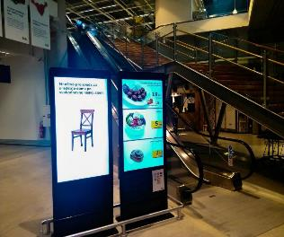

IDS Totem
Communication with the customers
Your content & scenario creation
Interactive touch
Special promo announcement
Comfortable interface
Сustomer service evaluation
Interactive catalog
News, Promo , Advertising.
All devices are controlled centrally

Slide 12
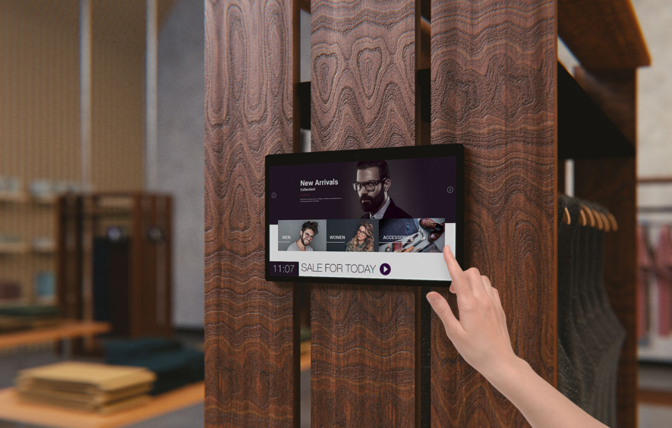
Android Tablets, Windows tablets & AIO in POS
Communication with the customers
Promotion & Special Offers
Comfortable interface
Fast content creation & changing
Triggers: Face detection и Motion detection
Offline content playing
Interactive catalog
News, Offers, Advertising
All devices are controlled centrally

Slide 13
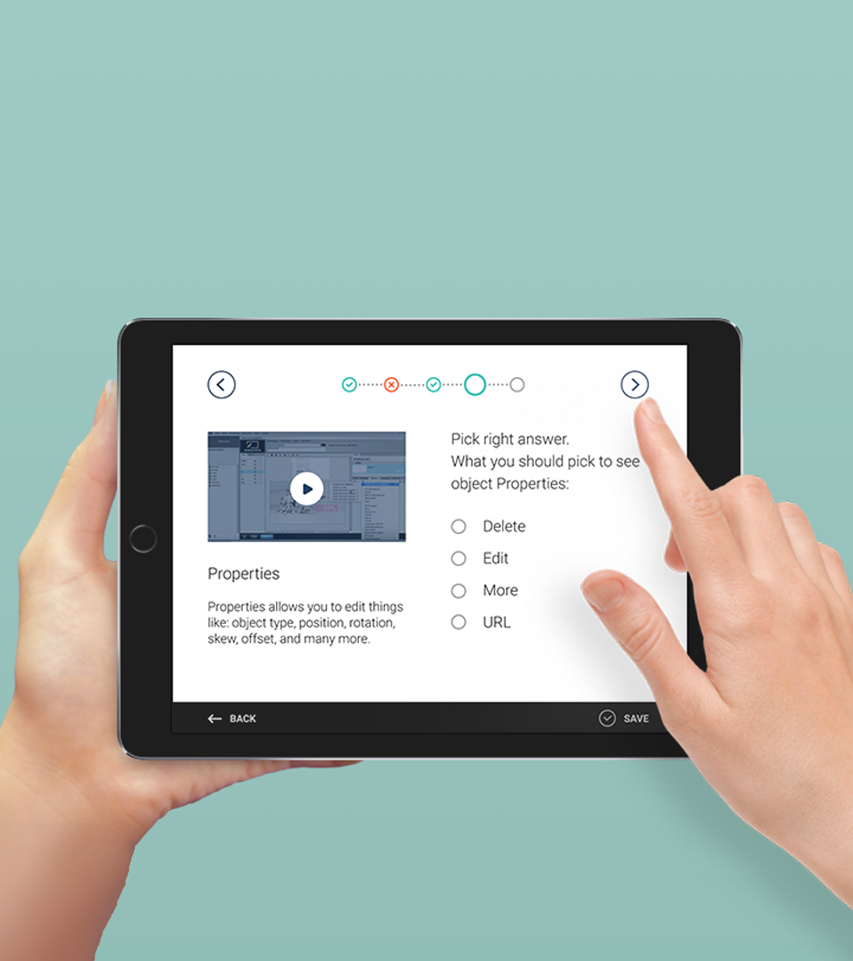
Staff training and informing system
Create the most effective service
Create the most effective service using online staff training. Launch it on your notebooks and smartphones according to schedule.
Combine knowledge and advertisement
Combine knowledge and advertisement at POS using onepoint information management. Interactive micro-lessons are available in application the day before promotions and their streaming at retail space using online audio and video advertising.

Slide 14

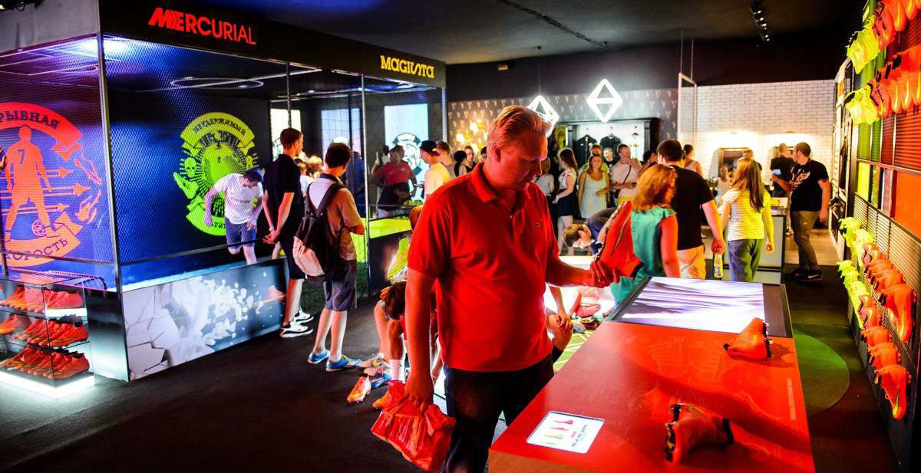
Project with the demonstration of the latest development & unique
points of Nike, which the customer can see immediately

Slide 15
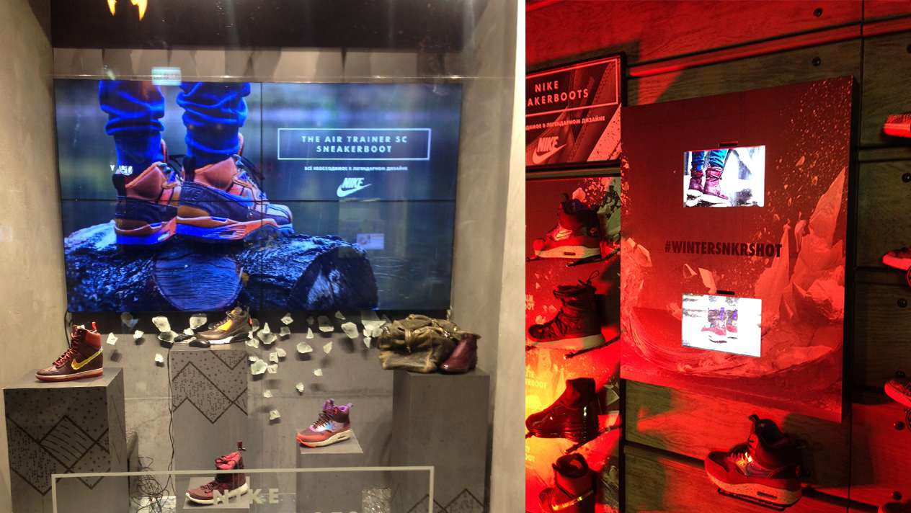
LCD Video Wall, Interactive Panels / AiO, with video & audio content
management remotely

Slide 16
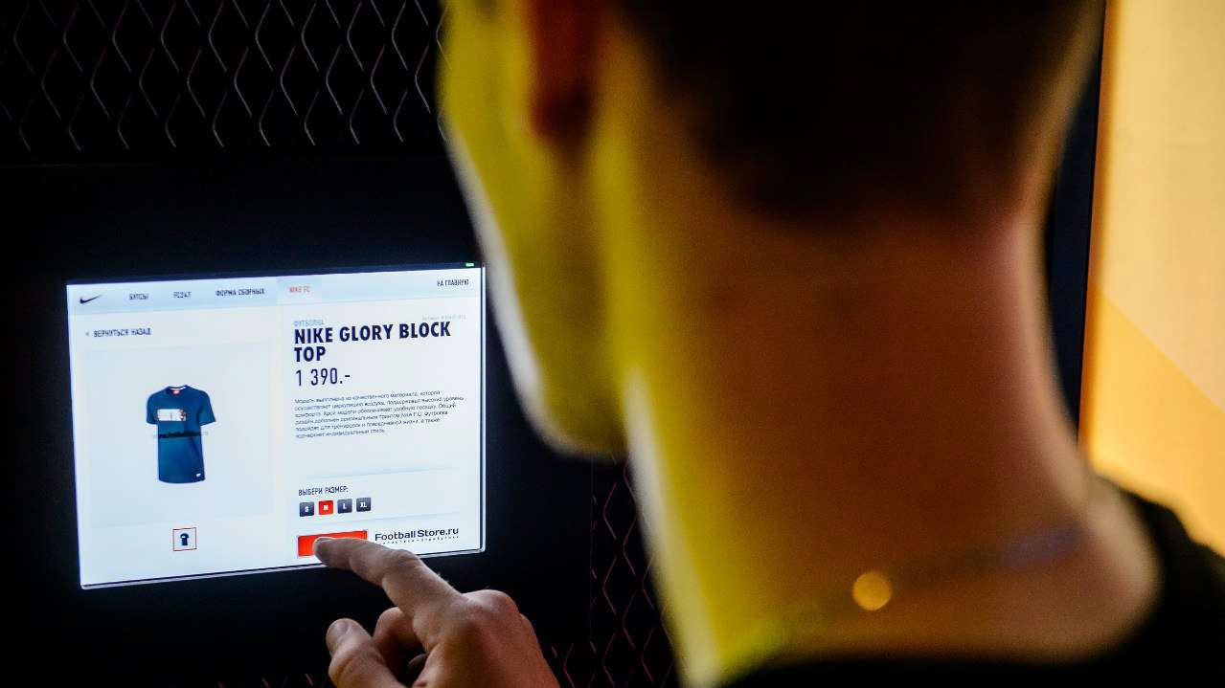
Each customer inside the Nike shop, in regards to LCD panels & Touch Panels (AiO) could receive full information about product & price immediately, also can choose the product he want & send the order.

Slide 17
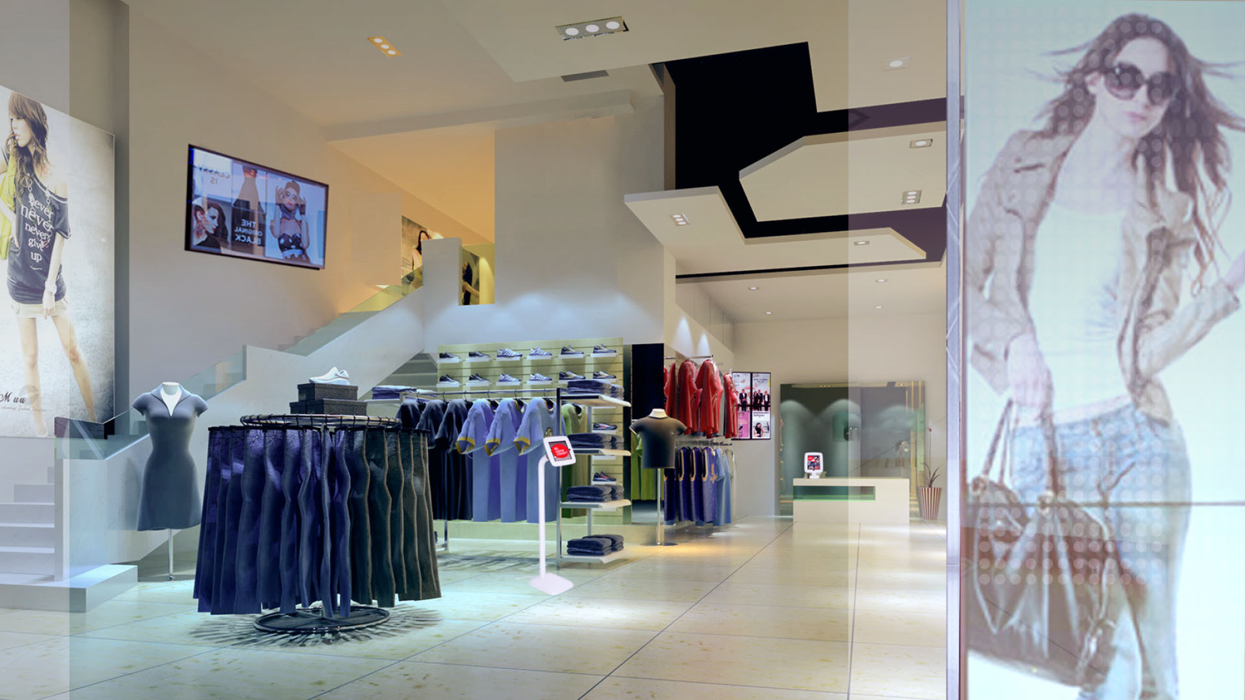

Slide 18

Prestigio DS application appearance cases
POS of the future
2
1
3
4
5
1
Transparent Poster / Wall
3
IDS Totem or Wall Mount
5
Tablets or AIO
2
IDS Wall Mount
4
Tablets or AIO solution

Slide 19

Digital Signage
Practical cases

Slide 20
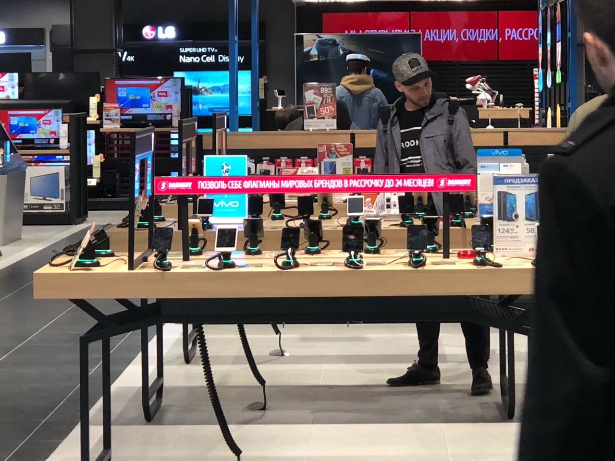
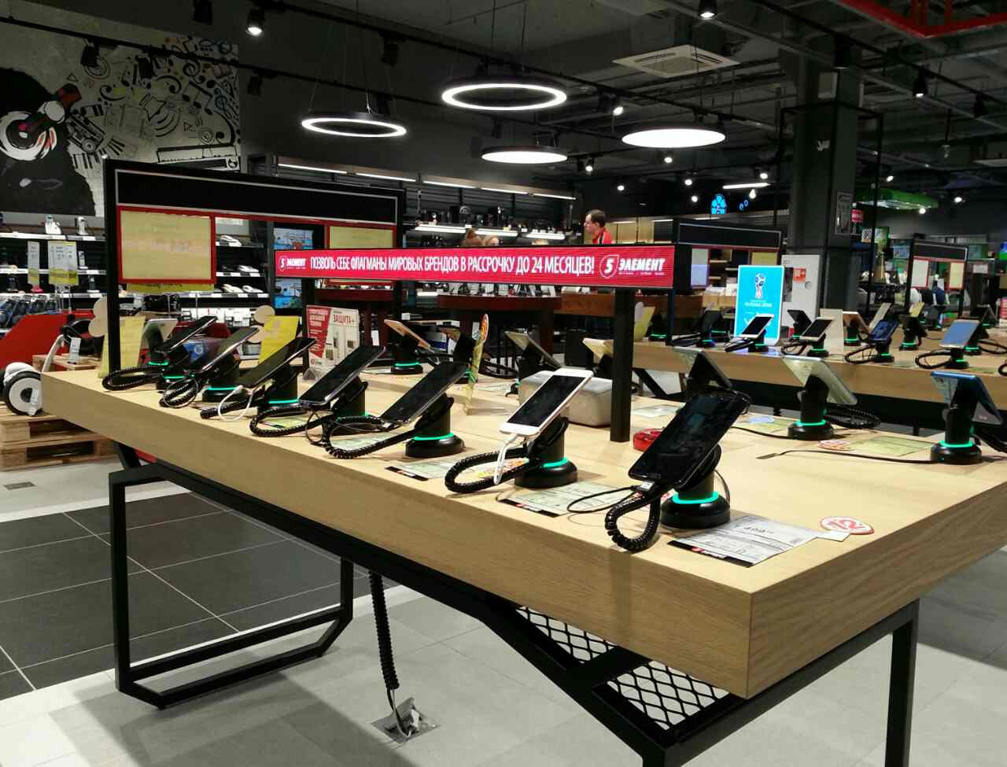
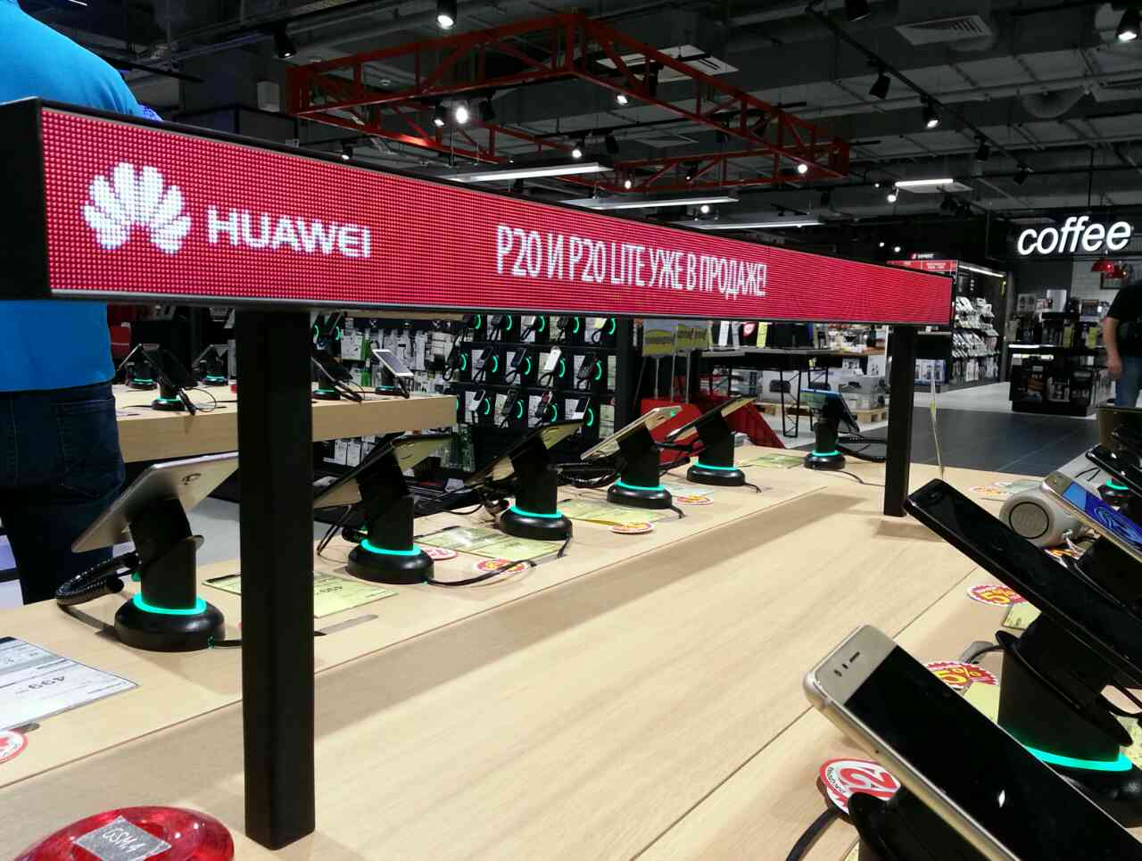
Electronics Retail LED shelves 5th Element project
Electronics Store Chain
5th Element, key retailer in Belarus, Minsk.
Project includes integration of LED shelf solution. Content managed by Prestigio AddReality IDS software.
Attracting the attention of the customers which just walking near the shop.
Increasing of the potential customers (inside the shop) up to 30%
Increasing sales from current shelf up to 23%

Slide 21
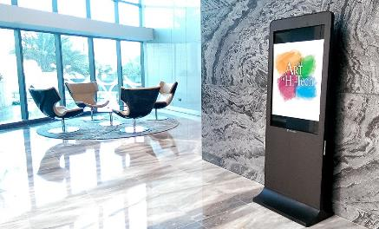

Prestigio IDS
Etihad Towers Business center guide, Abu Dhabi, UAE
Prestigio IDS Solution based on Prestigio IDS Totem 43” with integrated PC & IS Windows + Prestigio IDS SW
Guide through the business center
Information about the meetings, restaurant menu…
Advertisement, Currency rates, News
Remote management of the content & device

Slide 22
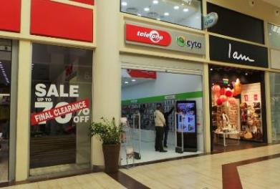

Prestigio IDS
Consumer Electronics Retailer, 30+ Locations in Cyprus
Prestigio IDS Solution based on IDS Totem 43” with Integrated Windows PC, Touch support & IDS SW
Advertisement & promotion information with Video / Audio content
Communication with the customers
Customers attraction
Full information about products & PROMO
Remote content management
Statistics & analytics collection based on Gender & Age of the customers to build right Sales strategy

Slide 23
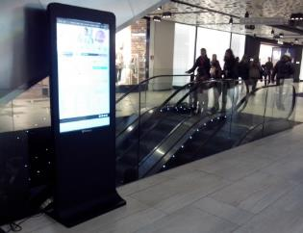

Prestigio IDS
Sarajevo City Center guide, Sarajevo, BA
Prestigio IDS Solution based on Prestigio IDS Totem 43” with integrated PC & IS Windows + Prestigio IDS SW
Guide through the Shopping Mall
Information about the Shop with the PROMO
Information about Bars & Restaurant with main menu
Advertisement, Currency rates, News
Remote management of the content & device
Targeted advertisement based on the Gender & Age recognition

Slide 24
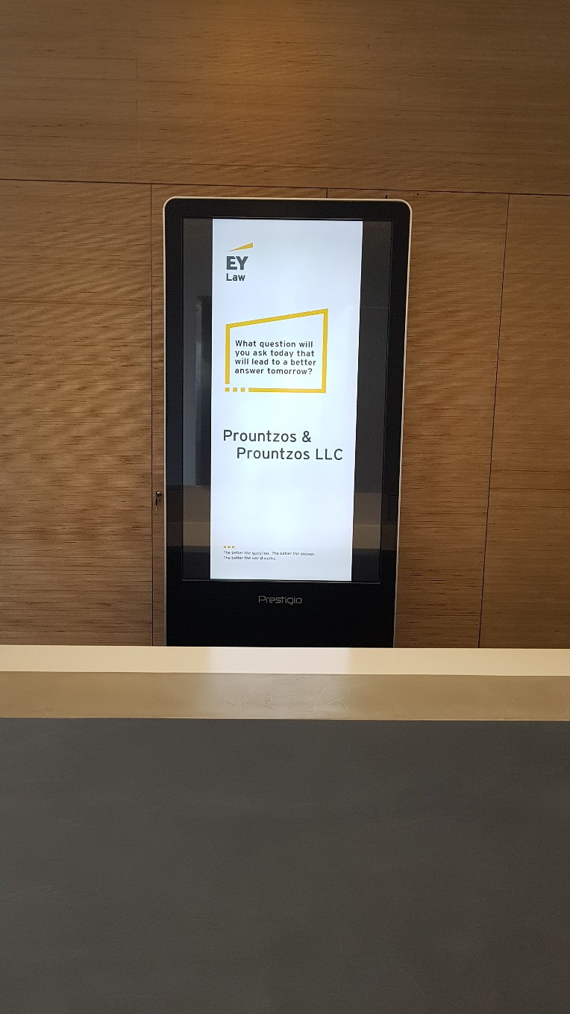
Cyprus
IDS solution: 55” Totem
Client: Prountzos and Prountzos LLC (Law firm)
Business need: totem is placed at reception area and used for advertisement and as information desk for clients
Sales channel: directly to end user
Decision maker: owner of the company
Client’s feedback: “Our customers started interacting with the Kiosk and were not asking all the time our receptionist for more information.
We are very satisfied with the product since we can push any advertisements that we want at any time. In addition we use it to advertise our companies in any corporate event that we take part in.”

Slide 25
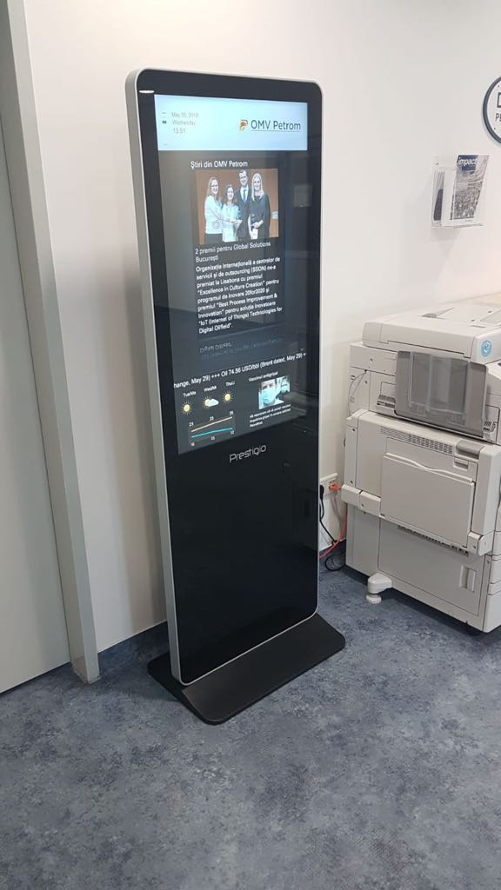
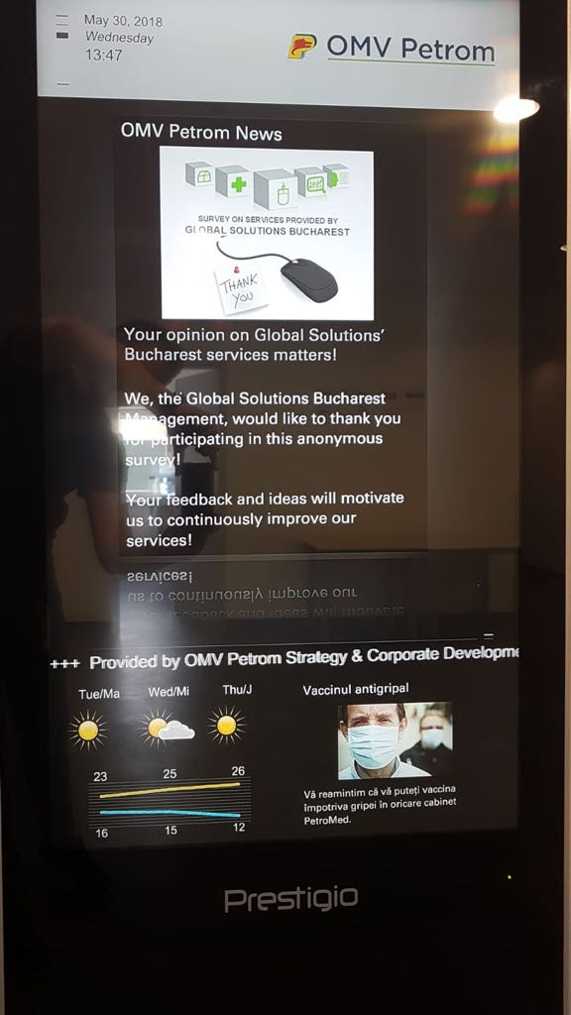
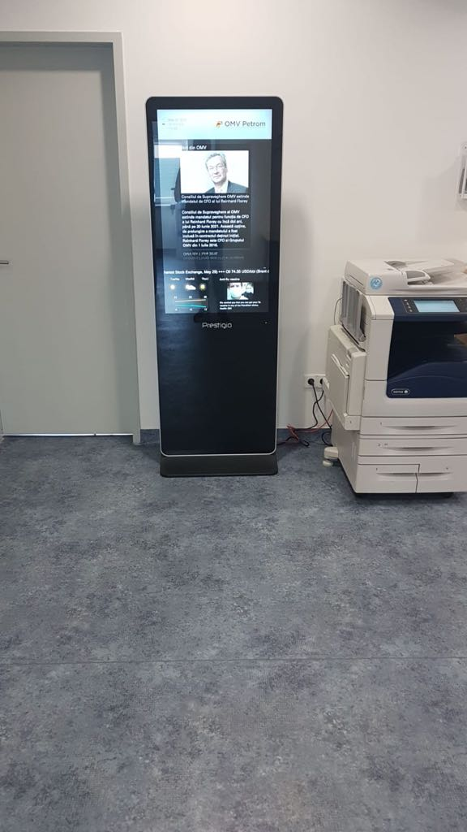
Romania
IDS solution: 43” Totem
Client: OMW Petrom (Oil&Gas)
Business need: displaying internal news, advertising and RSS feeds (placed in office space), aimed to enhance employees loyalty and motivation
Sales channel: Asbis RO has close contact with the end customer, however the sale was made via integrator
Decision maker: service manager
Client’s feedback: client is happy and considering purchasing of more totems.

Slide 26
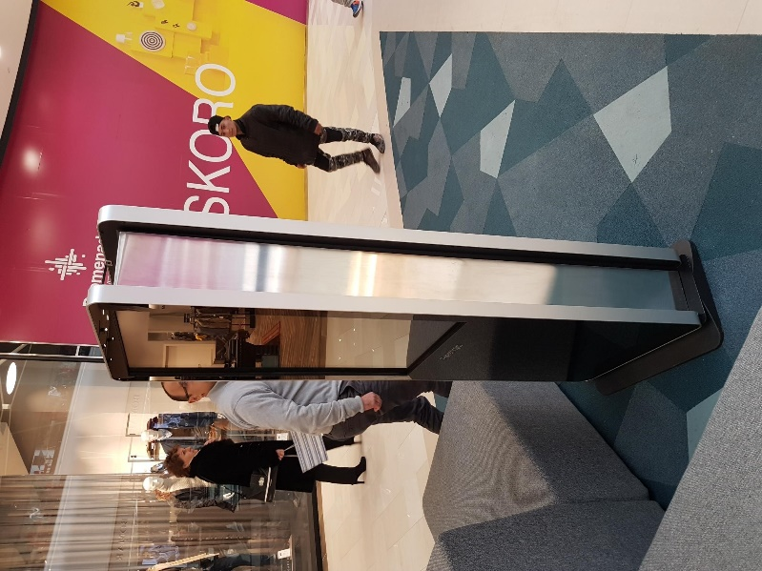
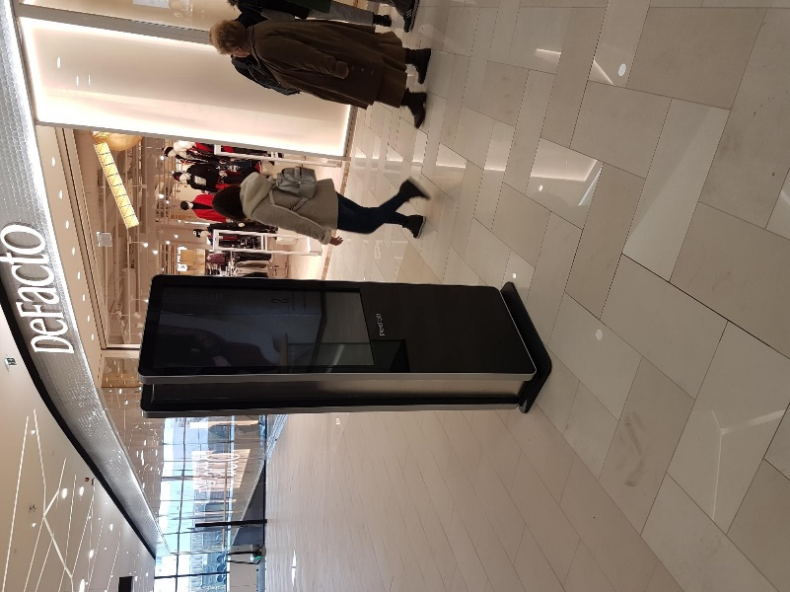
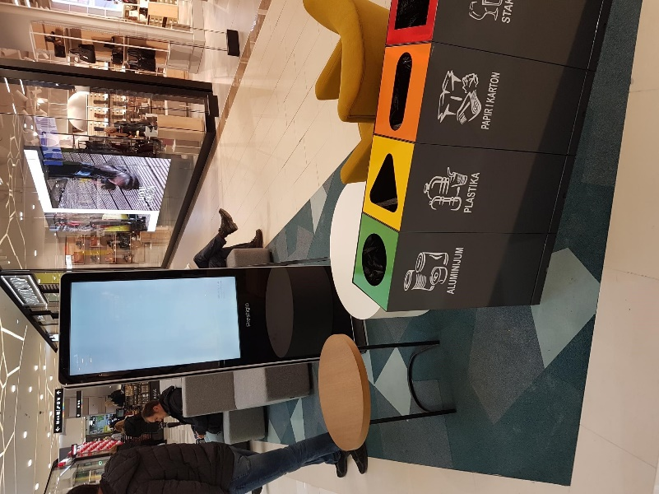
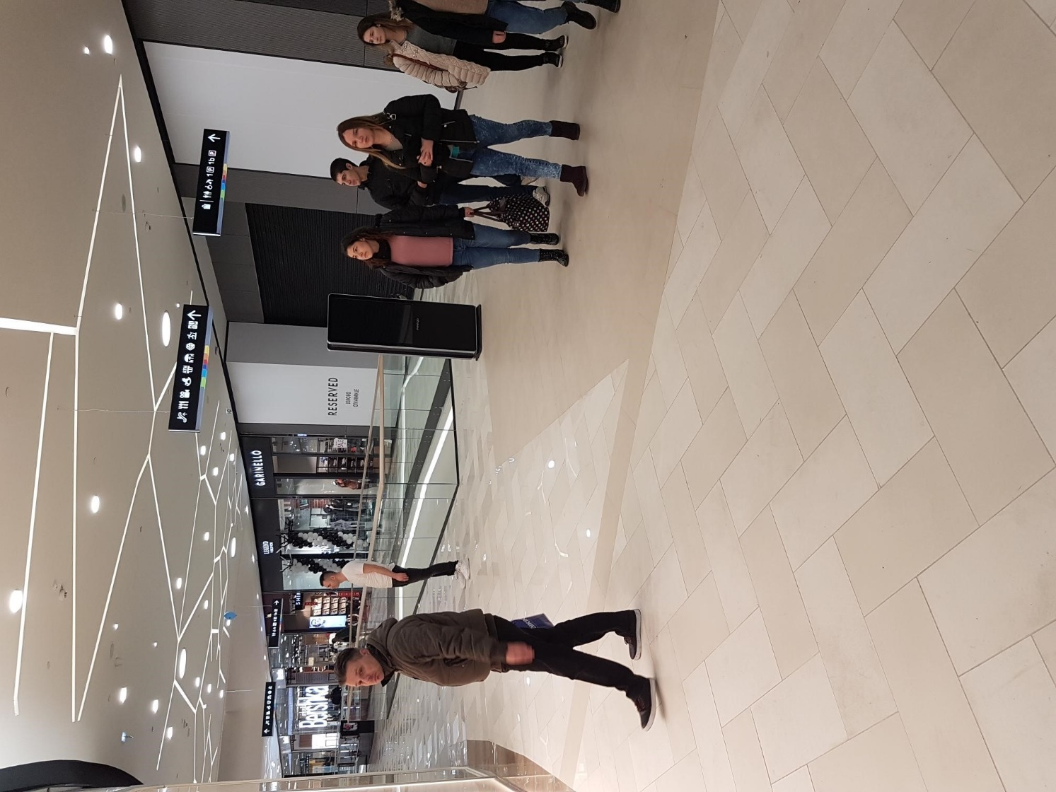
Serbia
IDS solution: 43” Totem, 10 units
Client: SKIPAD advertisement agency
Business need: attract visitors to the shops, situated in the moll; effective placement of promo content
Sales channel: the deal was negotiated directly with the client, while the installation was done by integrator
Decision maker: Marketing director
Client’s feedback: attracts visitors are to the totem, watch adverts, taking pictures etc.

Slide 27
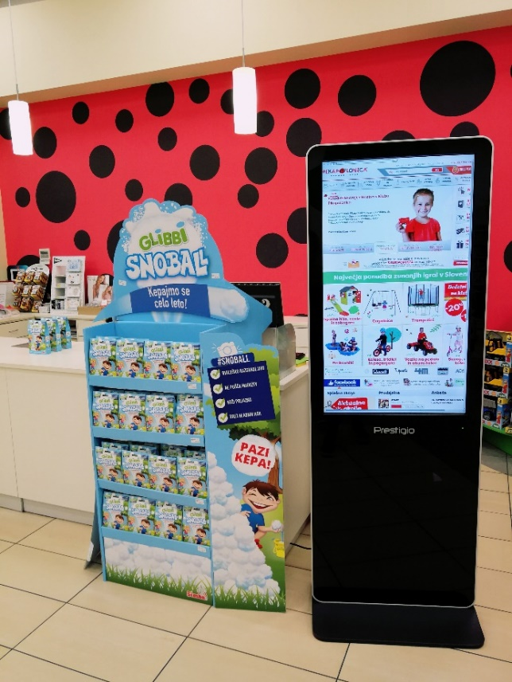
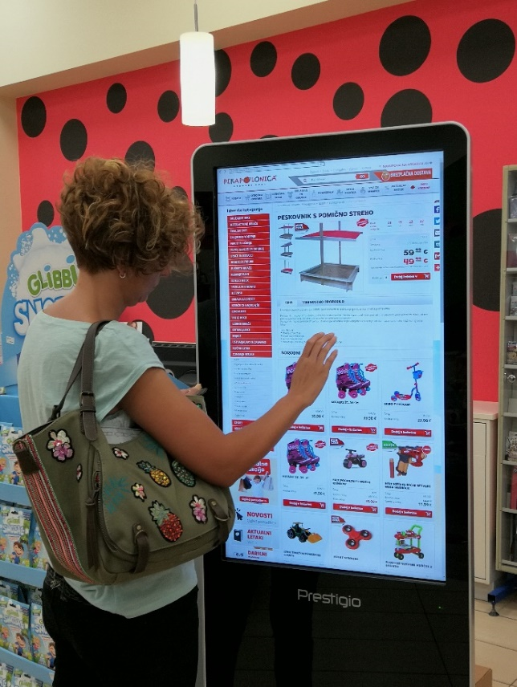
Slovenia
IDS solution: 43” Totem
Client: Pikapoka d.o.o. (retail, children products)
Business need: Display of marketing promotions and new product offerings, so that to raise customers’ activity and increase sales
Sales channel: Local sales team was the main contact for the client and it closed the deal. However, totem was sold through partner Teksel, as they are responsible for after-sales support.
Decision maker: Director

Slide 28
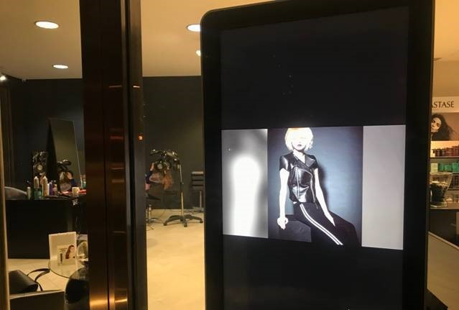
Bulgaria
IDS solution: 43” Totems
Client: Stephan salon (Beauty&Wellness)
Business need: Totems are place in shop window of salon to attract customers from the moll
Sales channel: directly to end user
Decision maker: Owner of the company

Slide 29
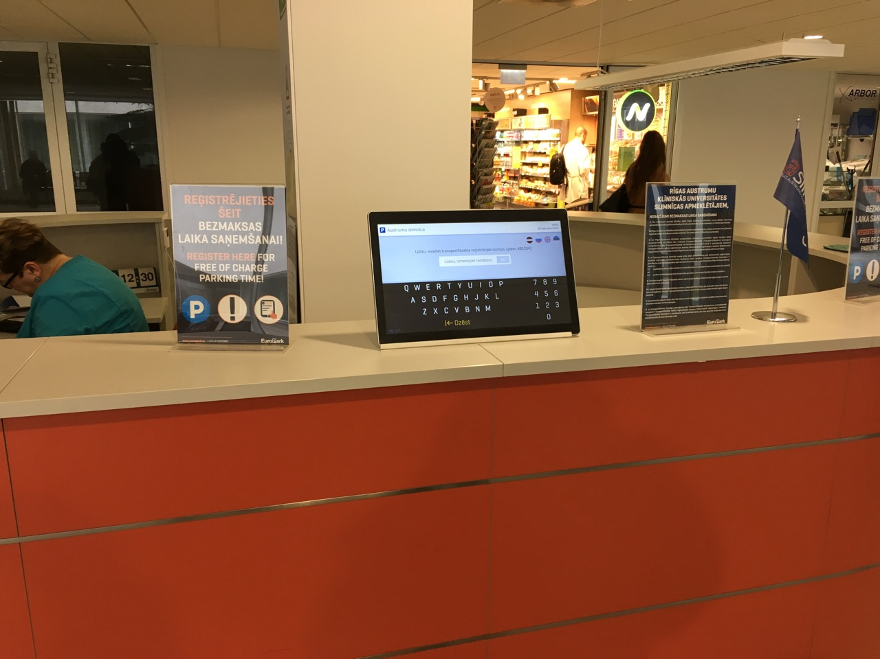
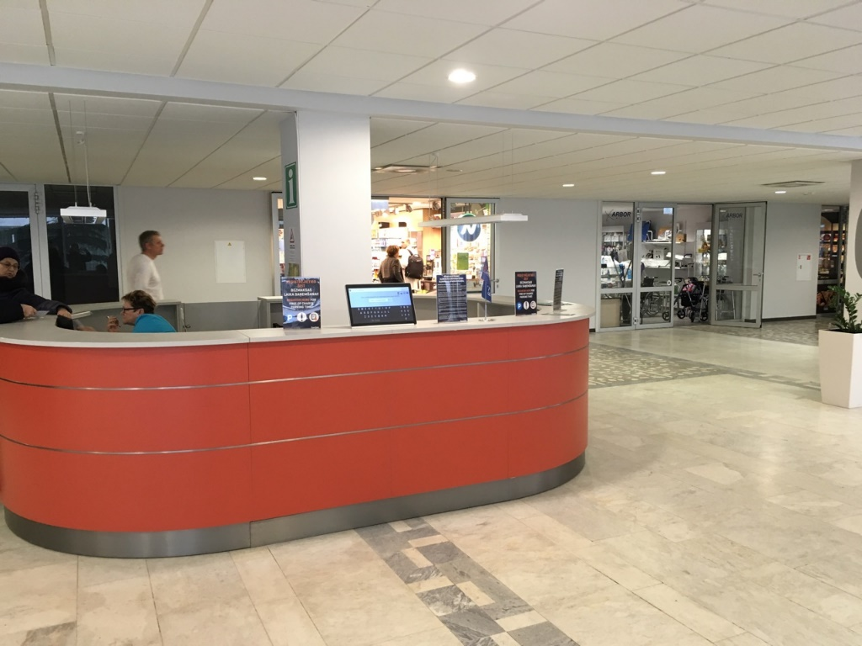
Latvia
IDS solution: 17,3” AIO
Client: Euro Park (parking)
Business need: Car registration on a parking in a hospital
Sales channel: directly to end user
Decision maker: Technical manager
Client’s feedback: Fast and convenient car registration

Slide 30
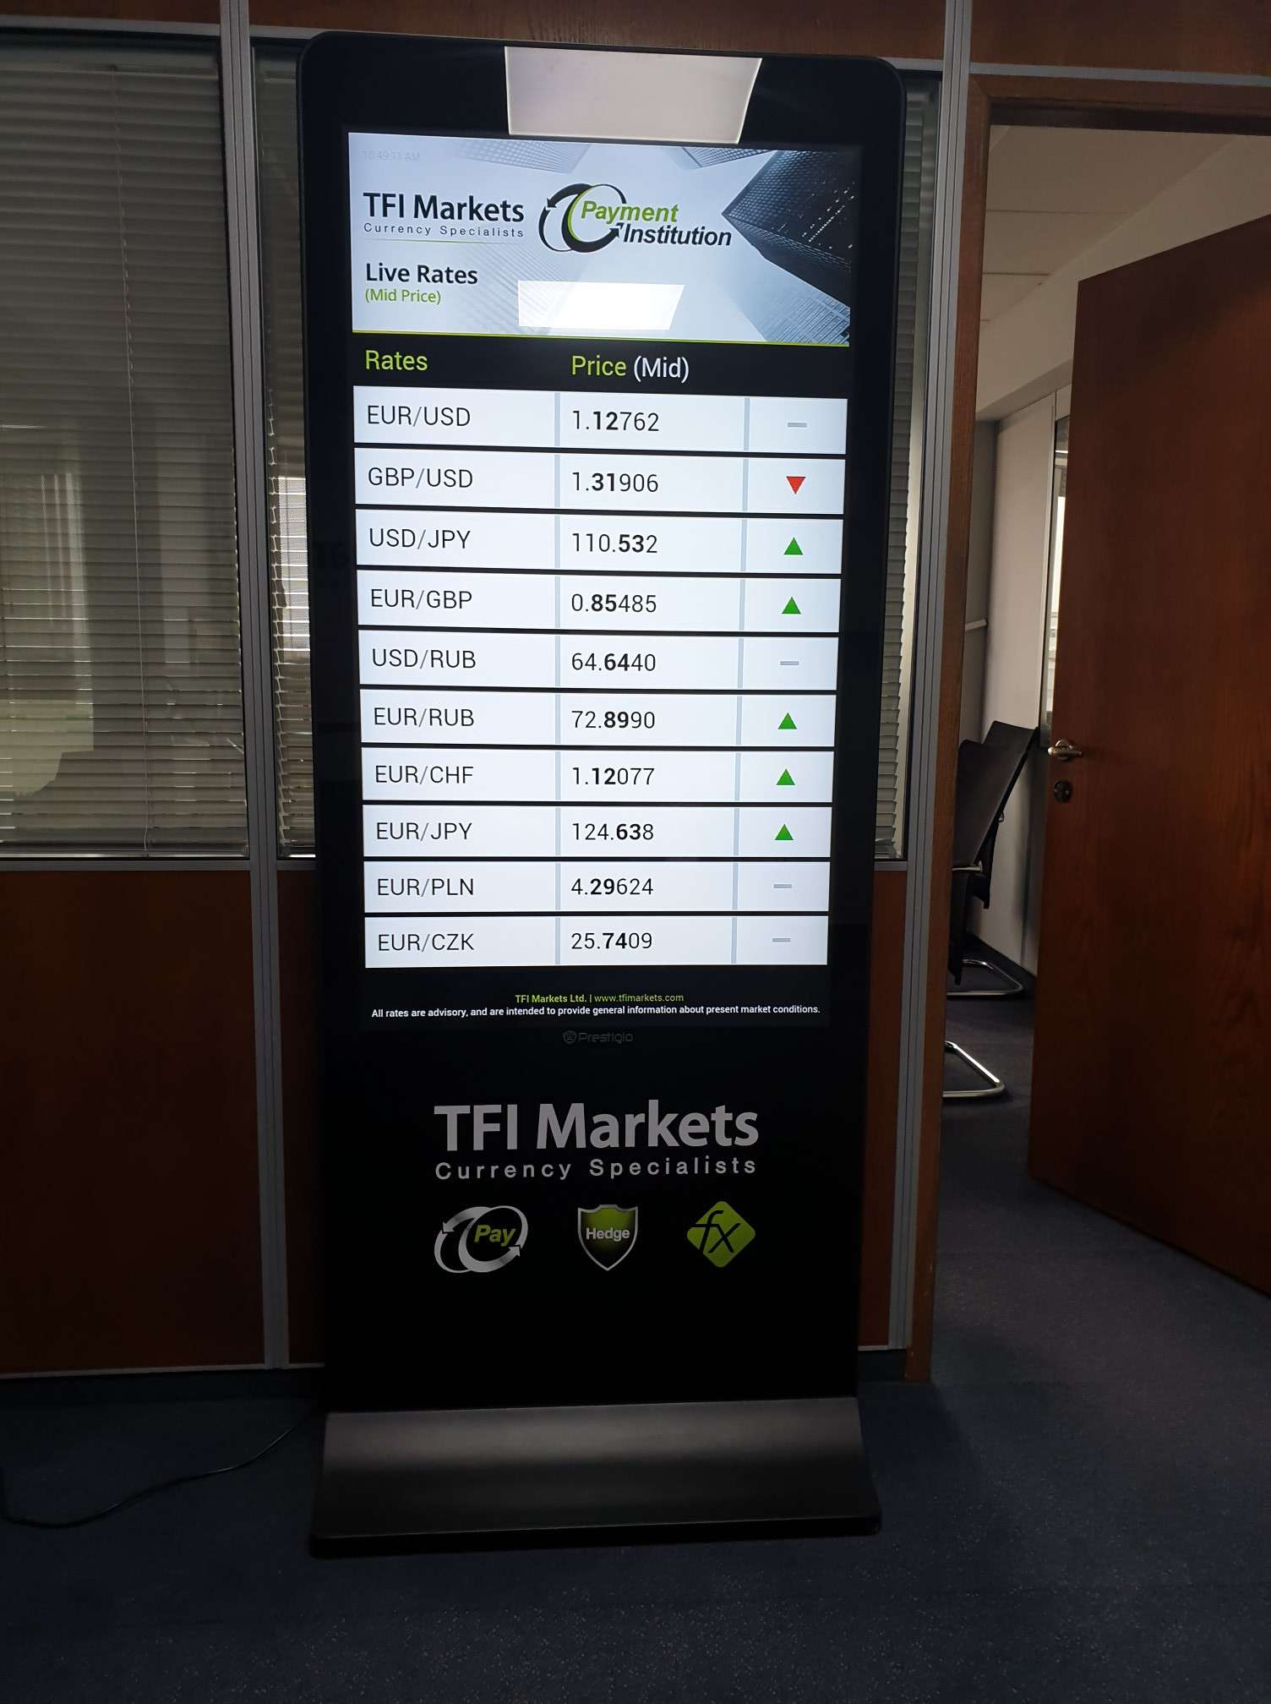
Cyprus
IDS solution: 43” Totem
Client: TFI Markets
Business need: display the currencies
Sales channel: directly to the end user
Decision maker: IT Manager, Marketing Manager
Client’s feedback: very satisfied with the solution and they are using it for many purposes

Slide 31


Cyprus
IDS solution: 43” Totem
Client: Limassol Marina Cyprus
Business need: Advertise their Villas at Four Seasons Hotel, Increase number of tourists
Sales channel: directly to the end user
Decision maker: Marketing Manager
Client’s feedback: They are very satisfied with the product

Slide 32


Belarus
IDS solution: LED shelf
Client: Technoplus
Business need: Increase sales from home shelf for Bosch
Sales channel: directly to the end user
Decision maker: Marketing Manager
Client’s feedback: Due to solution the most expensive washing machine was sold in a week
Navigate to the picture to start the video

Slide 33


Belarus
IDS solution: 42” tilted totem
Client: 5 Element
Business need: presentation of full assortment, option to order goods to a particular shop, enhancement of customers’ experience and stay in the shop
Sales channel: the deal was negotiated directly with end user. However sales was made via integrator
Decision maker: Business development manager, IT Director
Client’s feedback: clients actively use totems

Slide 34
Belarus
IDS solution: 42” tilted totem
Client: 5 Element
Business need: presentation of full assortment, option to order goods to a particular shop, enhancement of customers’ experience and stay in the shop
Sales channel: the deal was negotiated directly with end user. However sales was made via integrator
Decision maker: Business development manager, IT Director
Client’s feedback: clients actively use totems

Slide 35



Belarus
IDS solution: 55” LCD video wall PDSIN55WNN0L
(9 pcs)
Client: Belorussian State University
Business need: effective demonstration of content (lectures, webinars) in an international conference hall
Sales channel: our long-term partner integrator
Decision maker: Rectorate
Client’s feedback: great value for the money

Slide 36


Lithuania
IDS solution: 55” LCD wall mount PDSIK55WNN0L+ Multicenter PAB4411+Prestigio Addreality (Signage license)
Client: State educational center
Business need: demonstration of actual info, courses timetable at the entrance area
Sales channel: via integrator
Decision maker: IT manager
Client’s feedback: quite positive feedback received from the client

Slide 37


Serbia
Solution: 2 x 55" IDS totems with 2 yearly licenses of Prestigio Addreality Interactive + Prestigio Addreality Designer 1Y
Client: Neptun N. Macedonia (IT retail)
Business need: playing and managing the content from website, attracting customers inside the shop
Sales channel: directly to end user
Decision maker: General Manager
Client’s feedback: They are expecting ROI to happen, they want to sell ads space to big vendors

Slide 38

Russia
Solution: 18*LED Shelves 60mm, 43” Totem
Client: «Пятерочка» retail chain, Moscow
Business need: enhance customer experience, showing of promo content and prices, attract more customers to the shelf and increase sales from the shelf
Sales channel: our long-term partner integrator
Decision maker: Customer trade marketing manager NKA
Client’s feedback: sales increase of goods from the shelves

Slide 39




Serbia
Solution: 15 x 55" IDS totems were placed at 141st Inter-Parliamentary Union Assembly, Belgrade, Serbia, October 2019
Client: National Parliament of Serbia
Business need: to navigate visitors and direct them to the needed locations. Totems were used as information points at the event
Sales channel: via integrator

Slide 40

Romania
Solution: 131 x 55" IDS LCS Wall Mounts
40 x 55” IDS LCD Video Walls were placed Carrefour Romania, in Corbeanca, December 2019
Client: Carrefour
Business need: to navigate visitors and direct them to the needed locations. Highlight advertisement & Promo
Sales channel: communication with BEU & sales with integrator
Navigate to the picture to start the video

Slide 41


Cyprus
Solution: MB 65" &Totem Touch 43
Client: Pafos Neapolis University
Business need: MB in conference room for presentations and meetings & info kiosk at reception area
Sales channel: End Customer
Decision maker: Group Purchasing Manager

Slide 42



Ukraine
Solution: MB 43’’, 86’’, LED Poster, Prestigio Addreality Software on premise
Client: Privat Bank, Kiev
Business need: create innovative environment and engaging customer experience in “Bank department of the future”
Sales channel: deal was agreed directly, but sale go via integrator
Decision maker: Marketing director

Slide 43


Ukraine
Solution: 55’’ LCD video wall, 3.5 mm bezel, 7pcs
Client: Mad House Bar, Lviv
Business need: equipment of bar area to provide video content for visitors
Sales channel: directly
Decision maker: Project manager

Slide 44

Belarus
Solution: 55’’ LCD wall mount PDSIK55WNN0L 4pcs
Client: Doner Kebab, Grodno
Business need: menu display
Sales channel: via integrator
Decision maker: Director
Client’s feedback: good quality for the price

Slide 45

Armenia
Solution: LED non-transparent video wall 2,976 PP
Client: Parliament
Business need: Information display in an assembly hall
Sales channel: via integrator
Decision maker: Head of integrator company

Slide 46


Estonia
Solution: Hand-sanitaizer
Client: Proscreen, integrator company
Business need: Information display at an event
Sales channel: via integrator
Decision maker: CEO of the integrator company
Client’s feedback: quite good, interesting in further cooperation

Slide 47

Belarus
Solution: Prestigio Addreality Software on premise
Client: Priorbank, Minsk
Business need: Content management within restricted access network on a video wall
Sales channel: via integrator
Decision maker: Marketing manager

Slide 48


Belarus
Solution: Prestigio Addreality Software on premise
Client: Historical and Archeological museum, Grodno
Business need: Content management on 13 info-points in the museum
Sales channel: via integrator
Decision maker: Museum management

Slide 49

Latvia
Solution: Hand Sanitaizer
Client: city market Imantas tirgus, Riga
Business need: provide additional options for advertisement to salespeople of the market
Sales channel: via integrator
Decision maker: Market manager

Slide 50

Ukraine
Solution: Complex solution consisting of:
PDSIN55WNN0L – 16 pcs
PDSIK55WNN0L – 4 pcs
PDSIK43CWT6P – 2 pcs
PMB528L652 – 1pc
Client: Government Academy
Business need: video content placement from room surveillance cameras, info points
Sales channel: via integrator
Decision maker: Director

Slide 51

Poland
Solution: 25 units of Prestigio Solutions 43” Tilted Totems powered by specialized Digital Signage Software
Client: Supercar show in Warsaw
Business need: provide an information system at the show and enable visitors to dive deeper into the world of exclusive cars.
Link to the video

Slide 52

Czech Republic
Business need:
Turnkey solution showroom in the biggest IT retail in Czech. Positioning Prestigio Solutions products as a comprehensive solution for business, education, videoconferencing.
Client: Alza Showroom, Prague
Solution:
Multiboard Prime 75" + PMBWMK Windows Hello Camera,
13MP UHD camera,
Collaboration Bar ALFA,
4K PTZ camera,
Speakerphone ALFA

Slide 53

Poland
Business need:
Classic Meeting Room with full functionality from Prestigio Solutions equipment & Software
Client:
Currency.com, crypto platform
Solution:
Multiboard Prime Series 75"
Stand & Wall Mount kit
Collaboration Bar Alpha
Speakerphone Alpha
JoinU Software
Feedback:
Client gets a conference room with full audio-visual solution together with dedicated software.

Slide 54


Cyprus
Solution:
Multiboard 65” and 86” Prime Series
JoinU 1 year license
Client: VERTEX INVESTMENT ASSETS, Financial market
Business need: equip conference rooms with comprehensive solution
Decision maker: СЕО

Slide 55

Cyprus
Solution:
Multiboard 65”Light and 86” Prime Series
JoinU 1 year license
Client: Brainrocket, Software company
Business need: to organize conference hall with full solution
Decision maker: IT Director

Slide 56


Thank you!

